Slide 1
Combining a Colormap with a Noisemap
Fei Xu
Groups: Minh Truong, Fei Xu, Floyd R

Slide 2
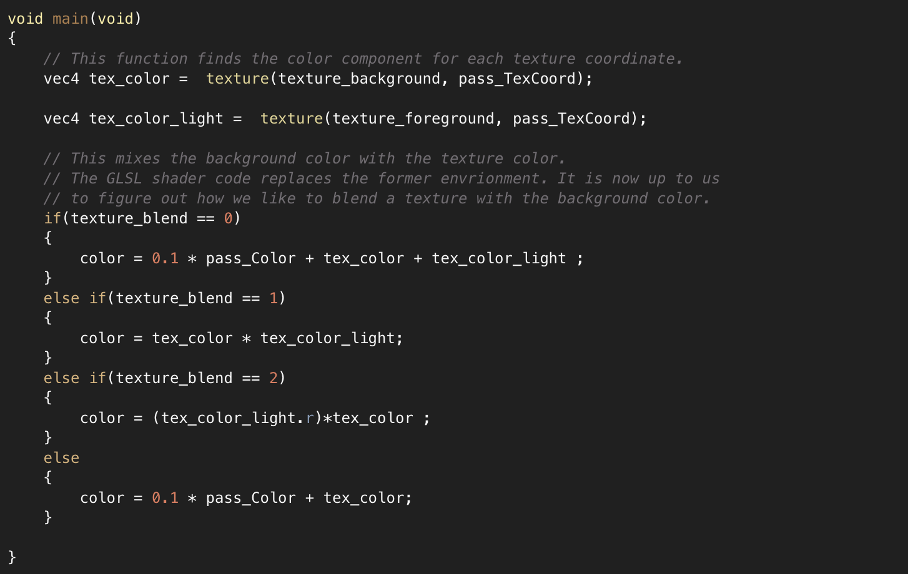
Multi-Texture

Slide 3
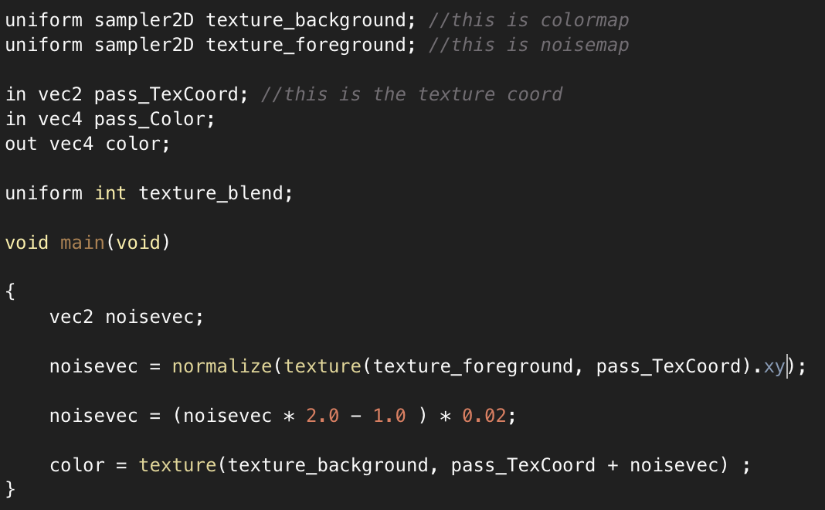
New fragment shader code

Slide 4
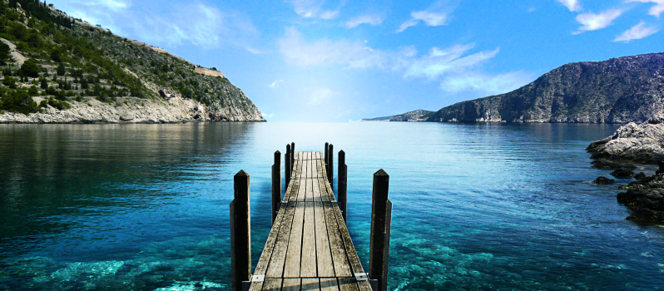
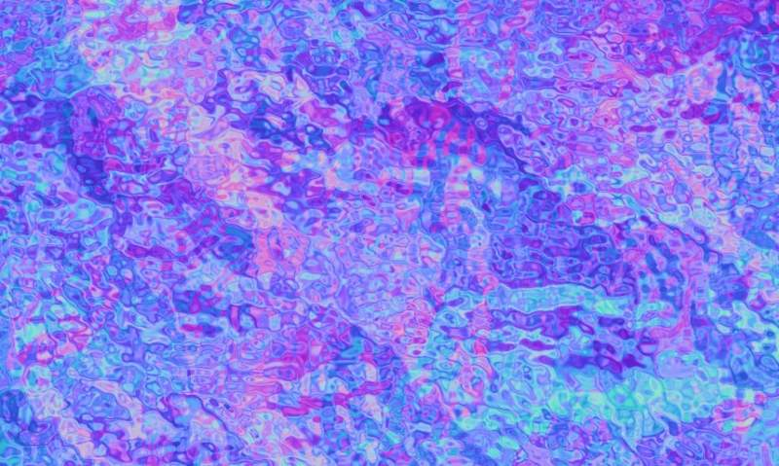
The colormap: a land scape
a noisemap

Slide 5
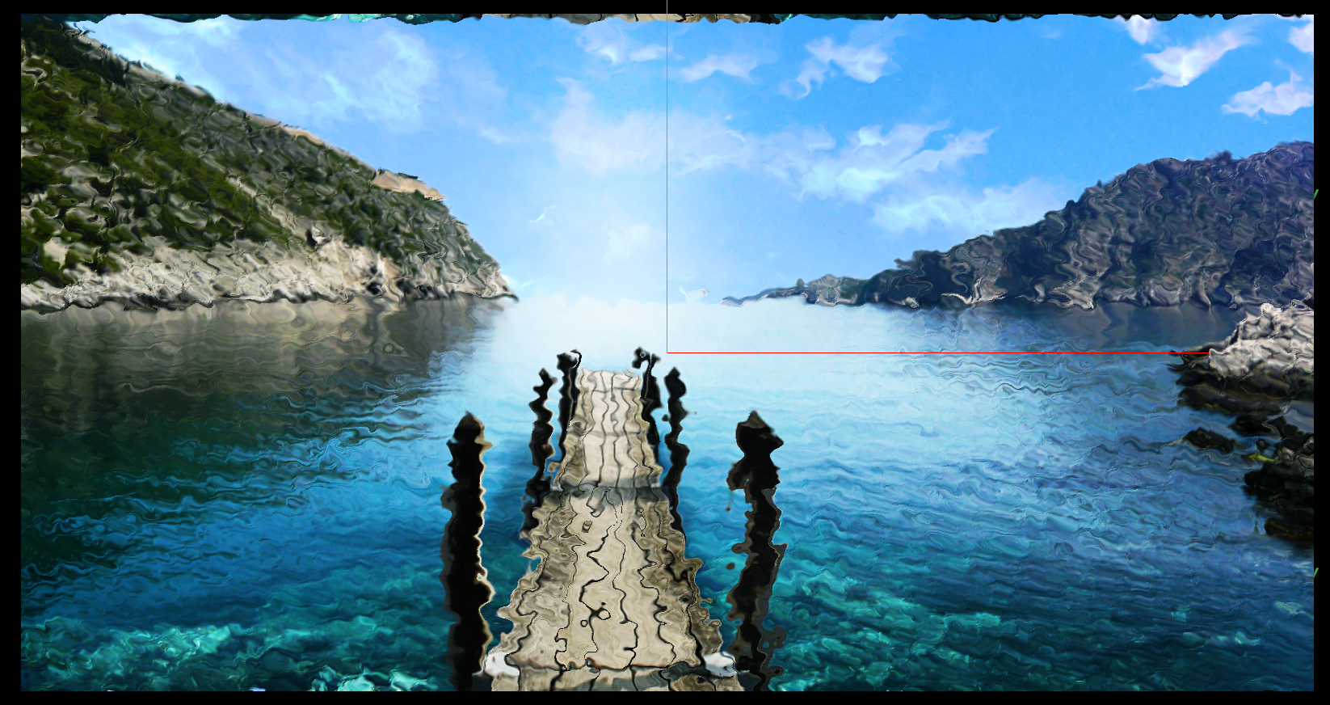
Results
noisevec = (noisevec * 2.0 - 1.0 ) * 0.02;

Slide 6
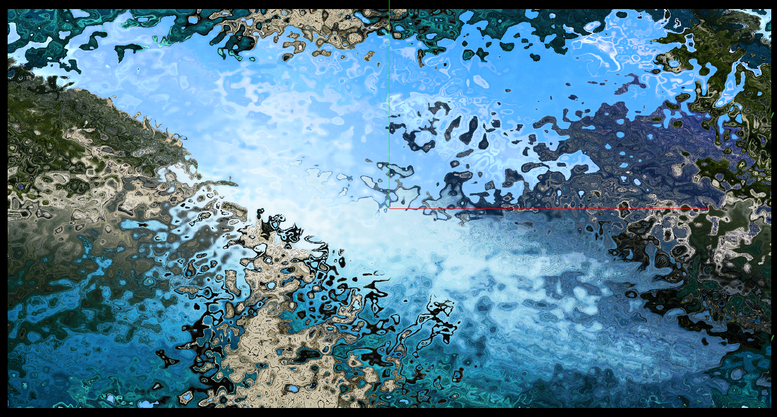
Results
noisevec = (noisevec * 2.0 - 1.0 ) * 0.2;

Slide 7
Chanlenges
The shader code to convert the RGB information to a displacement vector.

